Slide 1
HandiWorks Studio
HOME
JEWELRY
CHARTS
ABOUT US
SEARCH
GROUP - 01

Slide 2
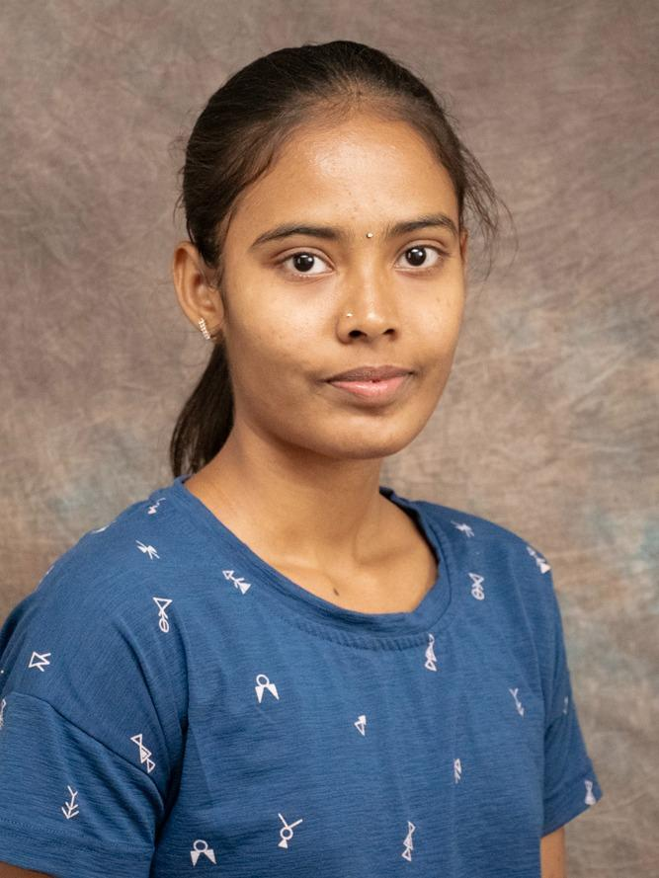

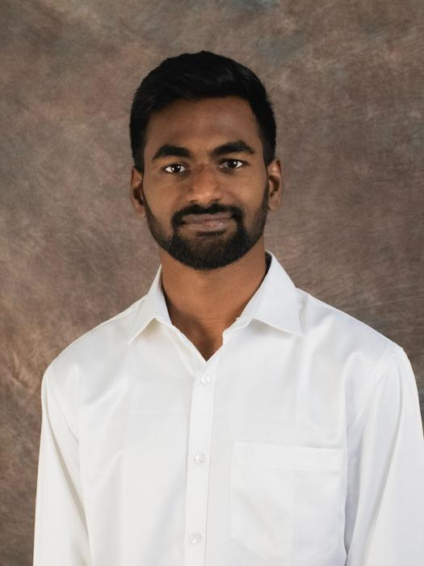
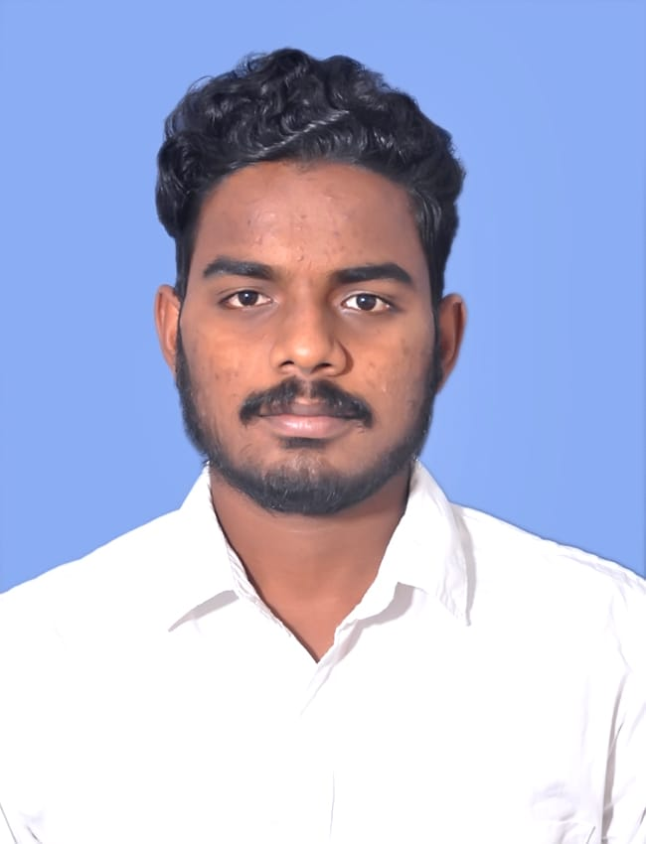
About us
Lavanya
U24723610
Lead Developer
Gowtham Sai
U84521734
UI/UX Designer
Tarun
U60500002
UI Designer
Vasudeva Reddy
U44373196
UX Designer

Slide 3
OBJECTIVE
HOME
JEWELRY
CHARTS
ABOUT US
SEARCH
An online platform for selling handmade and handcrafted items, engaging customers, expanding market reach, showcasing creativity and innovation, and promoting sustainable practices.

Slide 4
Site Goals
HOME
JEWELRY
CHARTS
ABOUT US
SEARCH
Targeted towards individuals who create and utilize handmade products, serving as the end-users.
Aims to facilitate the expansion of small retail shops throughout the country.

Slide 5
02
Forms & Validations
HOME
JEWELRY
CHARTS
ABOUT US
SEARCH

Slide 6
03
CRUD Operations
HOME
JEWELRY
CHARTS
ABOUT US
SEARCH

Slide 7
04
Charts
HOME
JEWELRY
CHARTS
ABOUT US
SEARCH

Slide 8

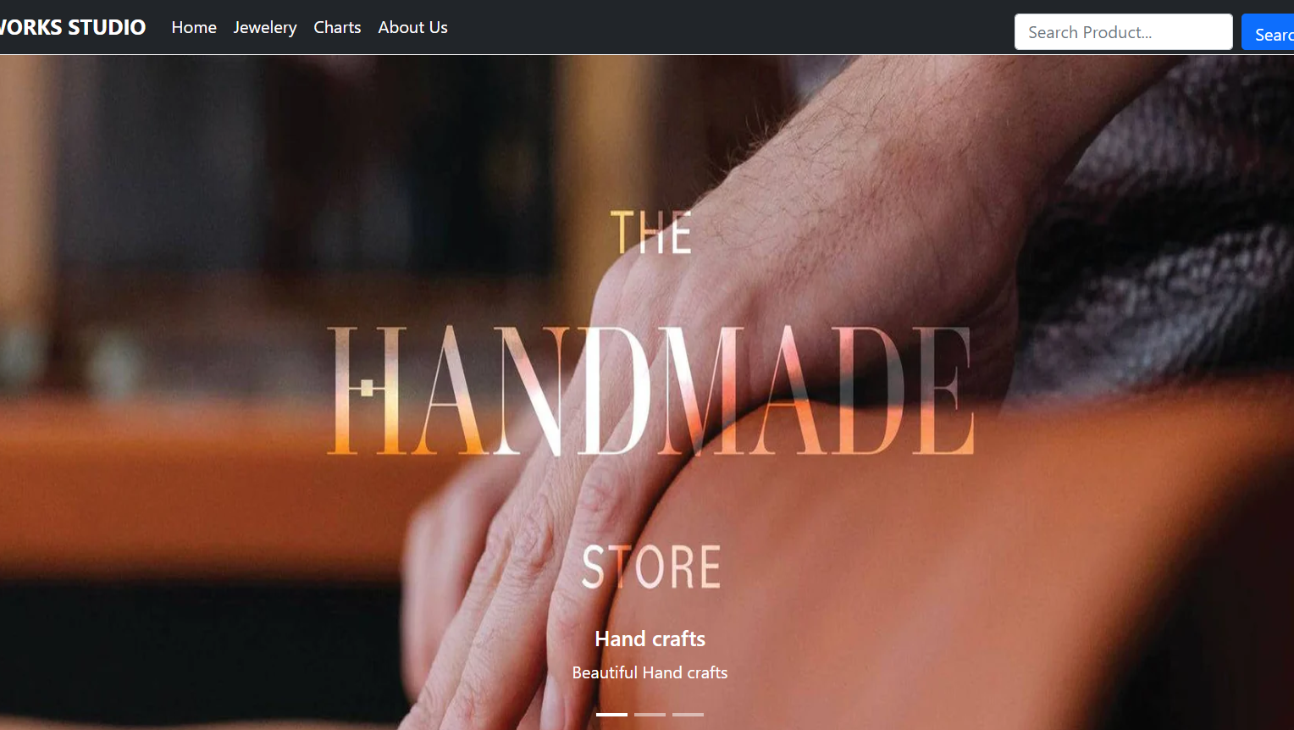

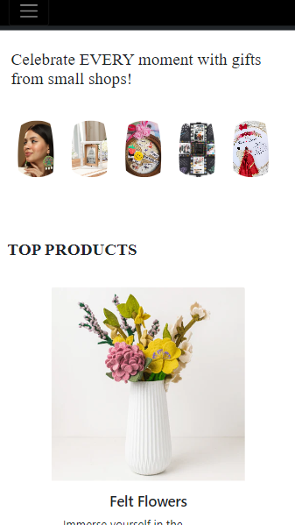
Responsiveness

Slide 9
Thank You
HOME
JEWELRY
CHARTS
ABOUT US
SEARCH

